Slide 1
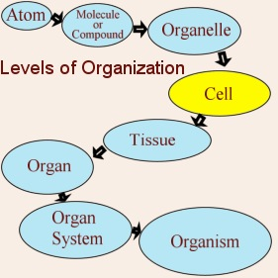
1.1 Characteristics of Life (p.3)
______________________________
______________ (Nerve cell)
______________ (Nervous tissue)
______________ (Brain)
____________________ (Brain, Spinal cord…etc)
_______________ (Human)

Slide 3
2. Living Things Acquire Materials and Energy
____________ is the capacity to do work.
Living things cannot carry on life’s activities without an __________ source of materials and ____________
______________ or ________________use carbon dioxide, water and solar energy to make their own food
______________ (humans) acquire materials and energy when they eat.

Slide 4
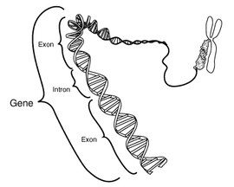
3. Living Things Reproduce
_____________ creates _____________.
____________ in the form of ______________ (deoxyribonucleic acid) allow cells and organisms to reproduce.
______________ is all the chemical reactions in the cell.
Reproduction can be ___________(mitosis) or ______________ (meiosis).

Slide 5
4. Living Things Respond to Stimuli
_______________ (a stimulus) is a change in the internal or external environment that a sensory receptor can detect.
__________________ is the response to a stimulus.
Behaviour is generally a response designed to __________________,
__________________, and/or
__________________.

Slide 6
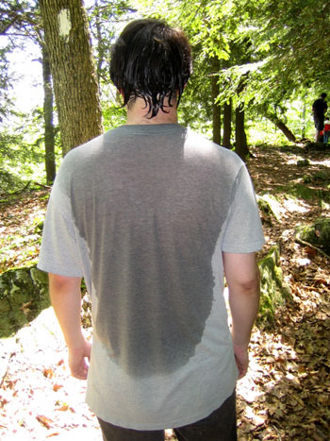
5.Living Things are Homeostatic
____________________ means “staying the same.” It is the relative constancy of the body’s internal environment.
All organ systems work together to maintain ___________________.
Ex: Humans try to maintain a body temperature of __________ C regardless of how hot or cold the _______________ is.

Slide 7
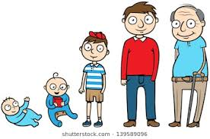
6. Living Things Grow and Develop
____________________ is the increase in the size and often the _________________ of cells.
Growth is a part of ___________________.
_____________________ is all the changes that take place between conception and death. (Ex: egg, zygote, embryo, fetus, baby, adolescence, adulthood, aging).

Slide 8
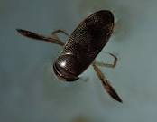
7. Living Things are Adapted
___________________ are modifications that make an organism suited to its way of life.
____________________ is the process by which a species changes through time.
__________________ are groups of similarly constructed organisms that can interbreed.
_________________ is the key to the diversity of life.

